Slide 1
class StringTest
{
public static void main(String args[])
{
System.out.println(2+5+"hello");
System.out.println("hello"+2+5);
System.out.println("hello"+2*5);
//System.out.println("hello"+2-1);
}
}

Slide 2
Output:
7hello
hello25
hello10

Slide 3
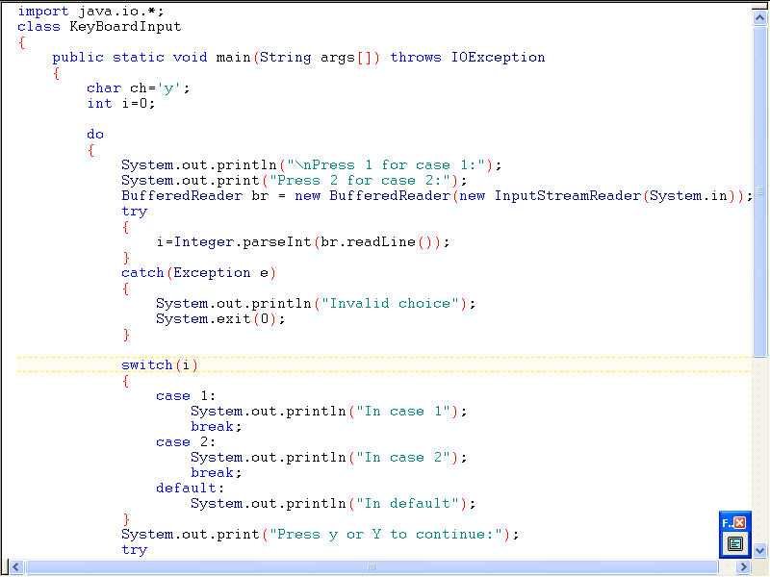

Slide 4
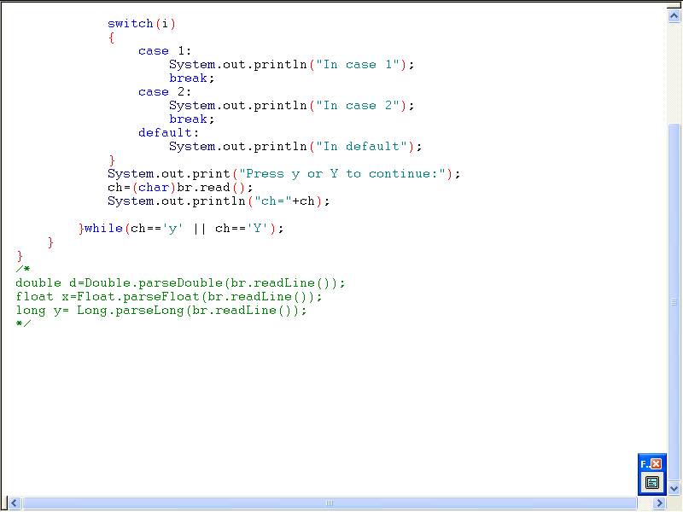

Slide 5
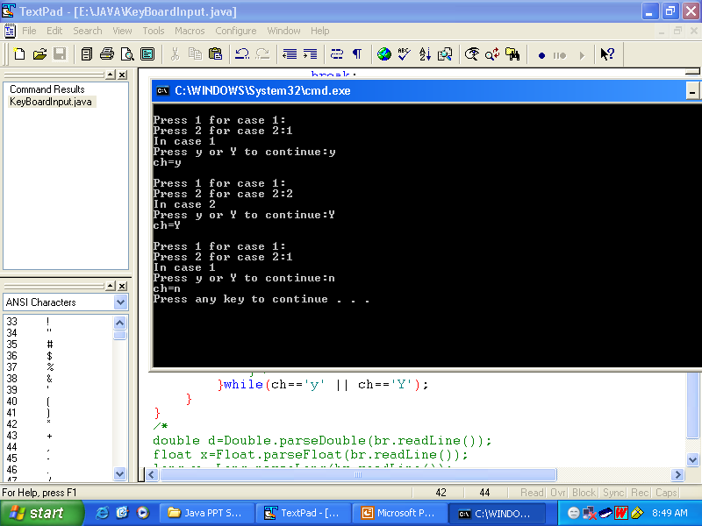

Slide 6
class CharacterInput
{
public static void main(String args[]) throws IOException
{
//It can be used to input any character from keyboard
System.out.println("Enter any character:");
char ch=(char)System.in.read();
System.out.println("ch="+ch);
}
}

Slide 7
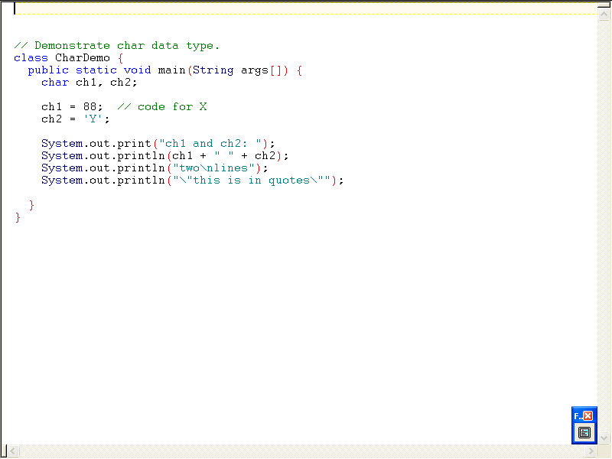

Slide 8
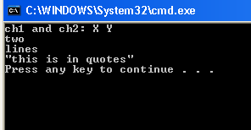

Slide 9
class ArrayTest {
public static void main(String args[]) {
int a[] = new int[3];
a[0]=3;
a[2]=5;
System.out.println(“Initially the array contains:");
for(int i=0;i<a.length;i++)
{
System.out.println("a["+i+"]="+a[i]);
}
a = new int[5]; //new dimension
System.out.println("Now the array contains:");
for(int i=0;i<a.length;i++)
{
System.out.println("a["+i+"]="+a[i]);
}
}
}

Slide 10
Output:
Initially the array contains:
a[0]=3
a[1]=0
a[2]=5
Now the array contains:
a[0]=0
a[1]=0
a[2]=0
a[3]=0
a[4]=0

Slide 11
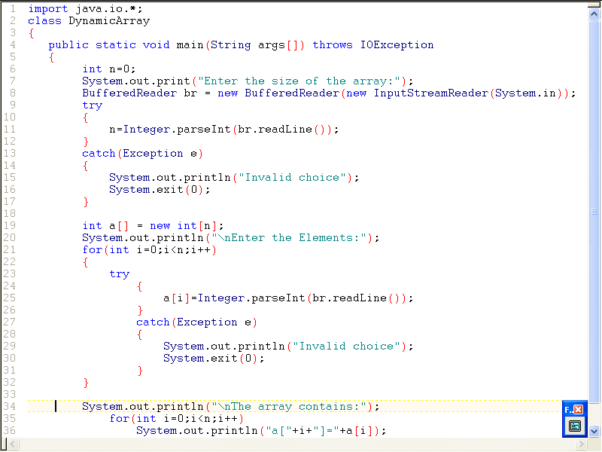

Slide 12
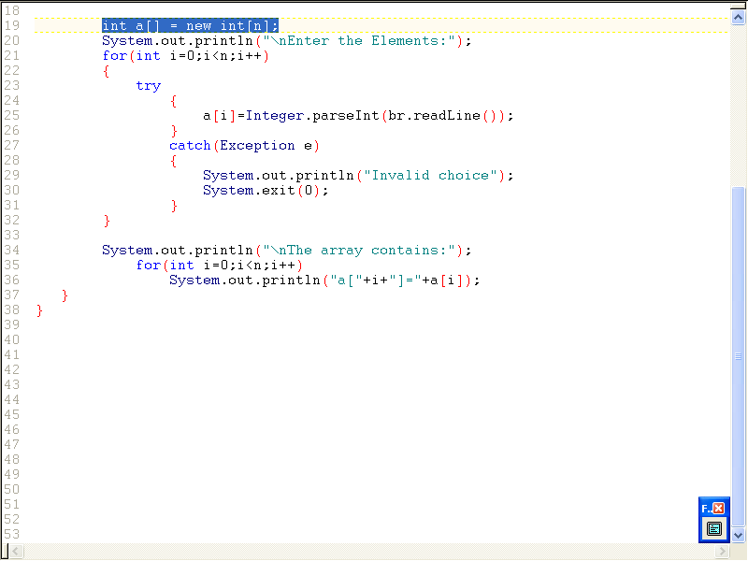

Slide 13
OUTPUT:
Enter the size of the array:3
Enter the Elements:
1
2
3
The array contains:
a[0]=1
a[1]=2
a[2]=3
Press any key to continue . . .

Slide 14
// Using the comma.
class Comma
{
public static void main(String args[])
{
int a, b;
for(a=1, b=4; a<b; a++, b--) {
System.out.println("a = " + a);
System.out.println("b = " + b);
}
}
}

Slide 15
Output:
a = 1
b = 4
a = 2
b = 3

Slide 16
// Using break as a civilized form of goto.
class Break
{
public static void main(String args[]) {
boolean t = true;
first: {
second: {
third: {
System.out.println("Before the break.");
if(t) break second; // break out of second block
System.out.println("This won't execute");
}
System.out.println("This won't execute");
}
System.out.println("This is after second block.");
}
}
}

Slide 17
Output:
Before the break.
This is after second block.

Slide 18
// Using break to exit from nested loops
class BreakLoop4
{
public static void main(String args[]) {
outer: for(int i=0; i<3; i++) {
System.out.print("Pass " + i + ": ");
for(int j=0; j<100; j++) {
if(j == 10) break outer; // exit both loops
System.out.print(j + " ");
}
System.out.println("This will not print");
}
System.out.println("Loops complete.");
}
}

Slide 19
Output:
Pass 0: 0 1 2 3 4 5 6 7 8 9 Loops complete.

Slide 20
class BreakErr
{
public static void main(String args[]) {
one: for(int i=0; i<3; i++) {
System.out.print("Pass " + i + ": ");
}
for(int j=0; j<100; j++) {
if(j == 10) break one;
System.out.print(j + " ");
}
}
}

Slide 21
// Using continue with a label.
class ContinueLabel
{
public static void main(String args[])
{
outer: for (int i=0; i<5; i++) {
for(int j=0; j<5; j++) {
if(j > i) {
System.out.println();
continue outer;
}
System.out.print(" " + (i * j));
}
}
System.out.println();
}
}

Slide 22
Output:
0
0 1
0 2 4
0 3 6 9
0 4 8 12 16

